Slide 1
Coping with Trauma in the Workplace
www.AmandaAnnGregory.com

Slide 2
Disclaimer
Follow your company policies and guidelines

Slide 3
Objectives
Learn how traumatic events impact you, your employees, and those you love.
Explore how trauma reactions manifest in the workplace.
Discover specific interventions to process and cope with trauma.

Slide 4
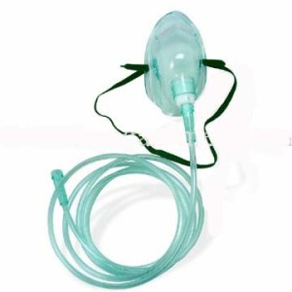
Think of…
Yourself (Oxygen Mask)
Your loved ones
Your employees

Slide 5
Using the Word ‘Trauma’
Popular Use
“That was traumatic”
“I’m traumatized”
Clinical Use
Trauma describes injuries that occur as the result of an event(s) or experience(s)
Mass shootings aren’t trauma, shootings can cause trauma
Not everyone who experiences mass shooting will experience trauma

Slide 6
Experiences that can cause trauma
Were you, your loved one, or your employees impacted by these events?
Active shooter
Highland Park, IL
Uvalde, TX
Sandy Hook
Buffalo, NY
Waukesha, WI
Natural Disasters
2011 tornadoes in Alabama
North Carolina’s hurricanes
Deaths of family members/friends, coworkers, leaders,
COVID/Illnesses
Suicide
Accidents
Natural
Deaths from Digging Accidents
2018 Dixon, IL – Father and son

Slide 7
Acute Stress vs Trauma
Symptoms are similar, the difference is time
Acute Stress = one month or less
Trauma = more than a month
April experiences nightmares for 2 weeks = Acute Ted has nightmares for 2 months = Trauma
Symptoms occurring during and after the event can be signs of healthy processing

Slide 8
Types of Trauma
Single event (PTSD)
One experience
One mass shooting
PTSD = trauma, but trauma does not equal PTSD
Complex Trauma/Developmental Trauma
Many experiences which occur during pivotal devotement stages (0-26 years old)
Childhood abuse
Disrupted attachment
Harassment in the workplace
Multiple mass shooting

Slide 9
If trauma was water in a glass
No trauma Single Event Complex/
Developmental

Slide 10
Has Something Changed?
Are you feeling (emotions and physical sensations), thinking, acting differently?
What about your loved one?
What about your employee?

Slide 11
Symptoms of Trauma
Emotional
Anxiety/Fear/Struggles to feel safe
Anger/Irritability
Depression/Greif
Confusion
Disconnection/Apathy
Struggle to regulate emotions
Low self-worth/pervasive shame
Physical
Muscle tension, GI/stomach issues, headaches, fatigue
More susceptible to illnesses
Decrease/increase appetite
Sleep issues: Insomnia/hypersomnia/nightmares
Chronic pain

Slide 12
Symptoms of Trauma
Cognitive
Lack of focus/easily distracted
Memory issues
Flashbacks or intrusive thoughts
Dissociation
Relational
Fight, Flight, Freezing, Fawning interactions
Social isolation or a need a lot of support
Struggles to feel safe with or to trust safe people.
Trusting unsafe/unhealthy people

Slide 13
Trauma impacts job performance and productivity
Lack of Concentration
Less detailed oriented
Less organized
Procrastination/avoiding tasks
Missing days/Leaving early
Constantly working
Taking on too many responsibilities
Always high performing

Slide 14
Trauma impacts workplace relationships
Social isolation
Conflicts with colleagues/authority figures
Low emotional tolerance
Talking about traumatic events often
Needing lots of reassurance/validating
Struggling to communicate their needs
Inflexible boundaries
People Pleasing

Slide 15
Trauma impacts career satisfaction/growth
Not seeking or taking advantage of opportunities
Unable to learn additional skills or pursue continued education/training
Less passion
Struggling to advocate for their needs

Slide 16
Imagine Experincing Trauma Responses in
A busy call center
An office
While attempting to support employees

Slide 17
Questions?

Slide 18
Using the word ‘trauma’
Don’t correct people
Focus on what they are communicating
Use the words that they use when describing their experience
“I’m traumatized” - You feel “traumatized.”
Use substitutes
Reaction
Impact
Injury
Don’t feel pressured to use clinical jargon

Slide 19
How Do I Talk to Someone about Trauma?
Curiosity
How are you coping/feeling?
Ask about physical symptoms, emotional, thoughts, actions
What’s work like for you now?
What’s helping? What’s not?
Empathy
Validation
Vulnerability
I’m feeling, I’m struggling with, Me too
Then, focus on problem solving, advice, feedback, provide resources

Slide 20
Trauma Processing

Slide 21
Processing Trauma
Express the trauma
Tell your story as much as needed
Use toys/figures to play out the event
Draw/Paint/Write/Sing/Create art
Focusing on body sensations/movement
Your oxygen mask
Take time and space to process
Feel your emotions and body sensations
Rely on social support
Couple processing with coping skills

Slide 22
Helping Others Process Trauma
Create safe spaces/relationships for trauma processing
Curiosity
Empathy
Validation
Vulnerability
Allow time and space
Model trauma processing and coping

Slide 23
Questions?

Slide 24
Coping with Trauma

Slide 25
Coping Skills
Not a fix
Not a “one size fits all”
You need multiple skills
Build a toolbox as the same skill won’t always work.
Does it work for you?
Notice how you feel
Practice often, even when it’s not needed

Slide 26
Limiting Media Exposure
Too much media (news/social media) can fuel trauma responses
How much exposure?
Checking often?
Always the background?
Creating Boundaries
Schedule it: Morning during coffee, lunch breaks
Frequency: 3 times a day
Limit outlets: 2-3 such as CNN, Facebook,

Slide 27
Brain Games
Refocus your brain with cognitive recollections

Slide 28
Brain Games Ideas
ABC
Choose a topic and name one for each alphabet
Examples: Kid’s movies: Anastasia, Babe, Coco
Cities: Anchorage, Boston, Chicago, Detroit
Lists
How many can you name?
Examples: Presidents, Countries, Companies in Chicago, Beyoncé Songs
Memorizing
Memorize something new and then recite it later
Examples: Song lyrics, poems, famous speeches

Slide 29
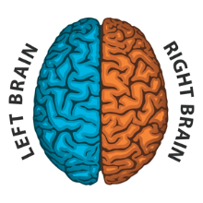
Deep Breathing with Bilateral Stimulation

Slide 30
Deep Breathing with Bilateral Stimulation
1) Breathe normally
2) Slowly breathe deeper with each breathe
3) Tap each side for your body at your own pace with your arms crossed
4) You can tap on your legs, shoulders or arms

Slide 31
Grounding with Senses

Slide 32
Grounding with Senses
Identify details that you can see around you
Touch something near you and notice what it feels like
Identify what you smell
Listen carefully and identify what you hear
Notice if you have any taste in your mouth, take a drink or eat something to create a taste

Slide 33
Relaxed Tense
Muscle Relaxation
https://tophat.com

Slide 34
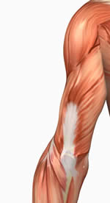
Muscle Relaxation
1) Tightly clench one muscle group
by tensing the muscles for 10 seconds
2) Let go for 20 seconds
3) When letting go, try not to move
that muscle group for 20 seconds
4) Repeat as needed

Slide 35
Open Posture

Slide 36
Open postures
Fast and easy way to show you’re body that you are safe
Get into your open posture
Notice your body
Meet your body’s needs

Slide 37
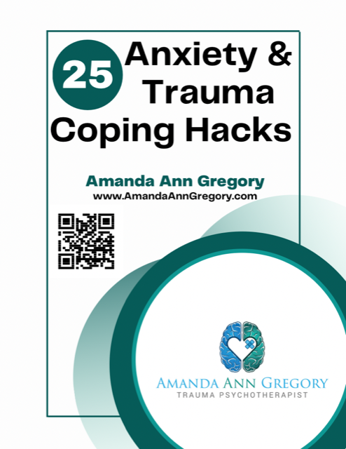
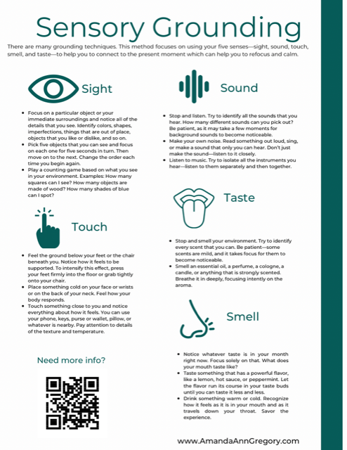
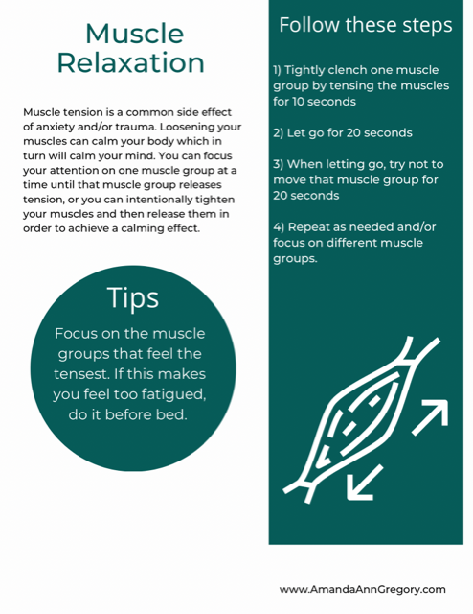
Free eBook
Sign up to receive your copy at
www.AmandaAnnGregory.com

Slide 38
You make a difference
“I feel safe at work. I know I can go to HR”
“My boss gets it.”
“I’m lucky to have them (colleagues).”
“If I need help, I know that I can ask.”

Slide 39
Contact Me
info@amandaanngregory.com
amandaanngregory
amandaanngregory
gregorytrauma

